Slide 1
Cluster Scheduling In Data Centers
Research Project
10 November 2022
Piyush Krishan Bajaj
st173644@stud.uni-stuttgart.de

Slide 2
Introduction

Slide 3
Introduction
Cloud Computing Clusters
Scheduling
Deep Learning Training
Heterogenity of Resources
Tasks performed in this project
Analysis of Throughput
Utilization of Cluster
New Policy Implementation

Slide 4
Background Information

Slide 5
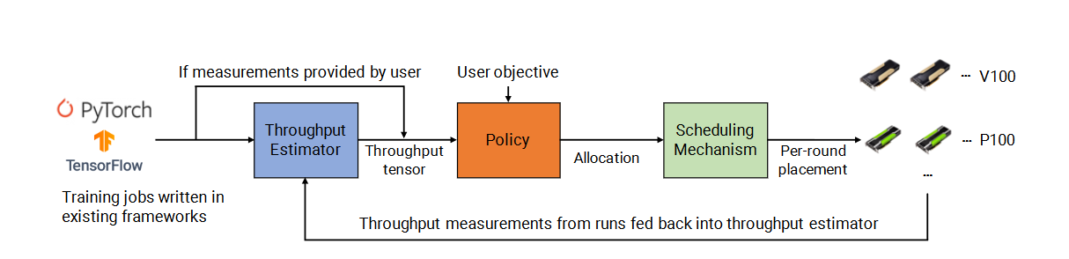
Background Information
Deep Learning schedulers
AlloX - improve performance while providing fairness
Gandiva - improve latency and efficiency based on domain knowledge
Themis - improve completion time on shared resources
Gavel
Gavel Overview

Slide 6
Approach

Slide 7
Approach
Throughput analysis
Utilization analysis
Shared Cloud Cost Fairness Metric
Algorithm

Slide 8
Throughput Analysis

Slide 9
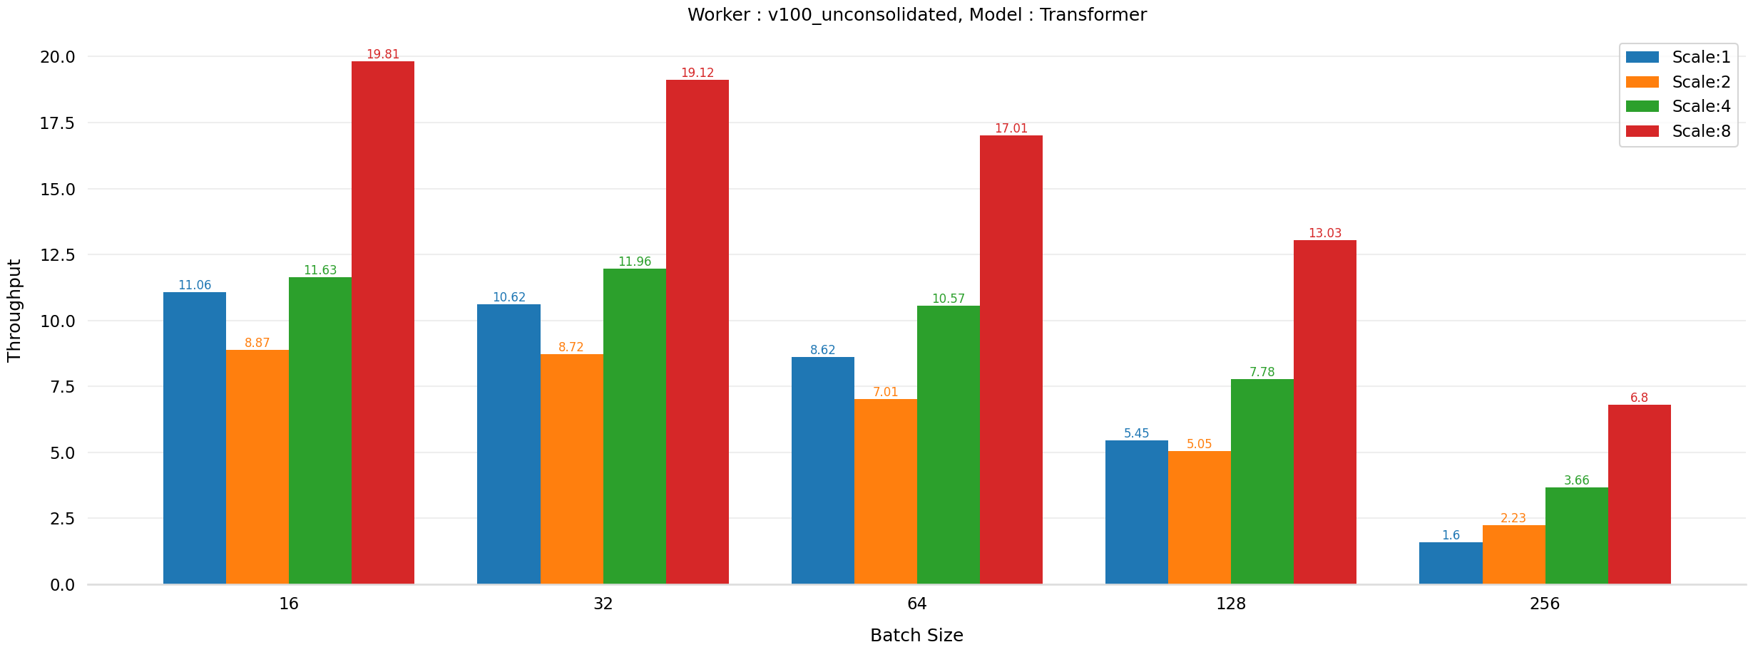
Throughput of Transformer model with various batch sizes and scale in unconsildated setting.

Slide 10
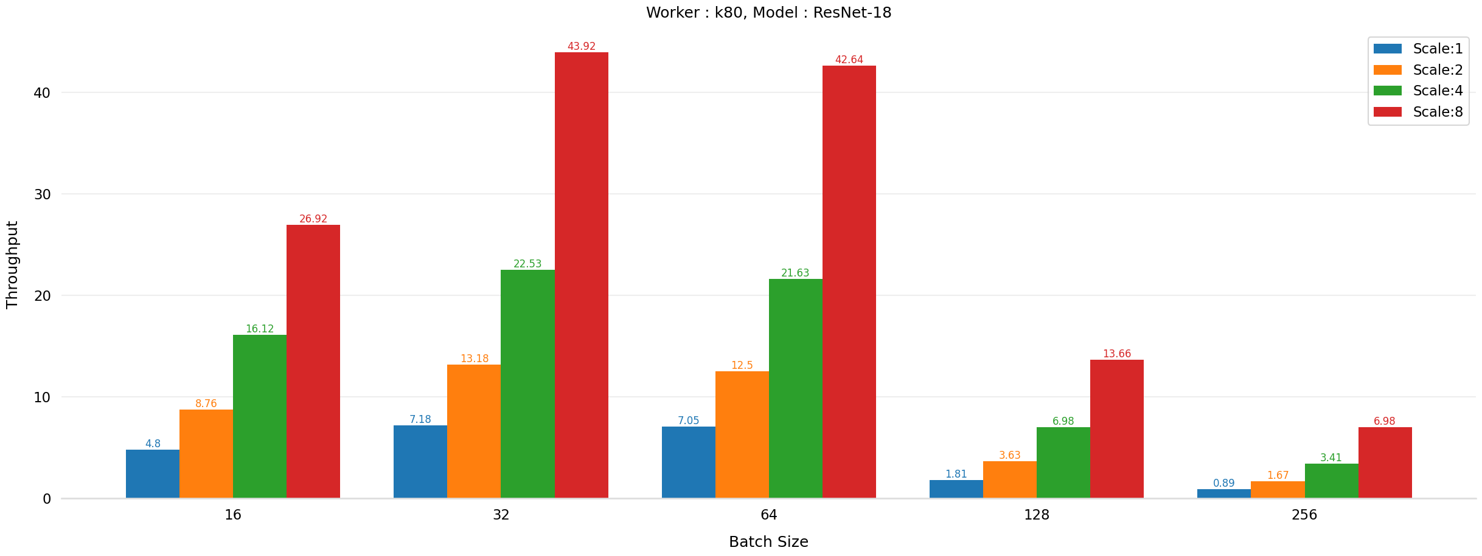
Increased throughputs with batch size
Throughput of ResNet 18 model with various batch sizes and scale in consolidated setting.

Slide 11
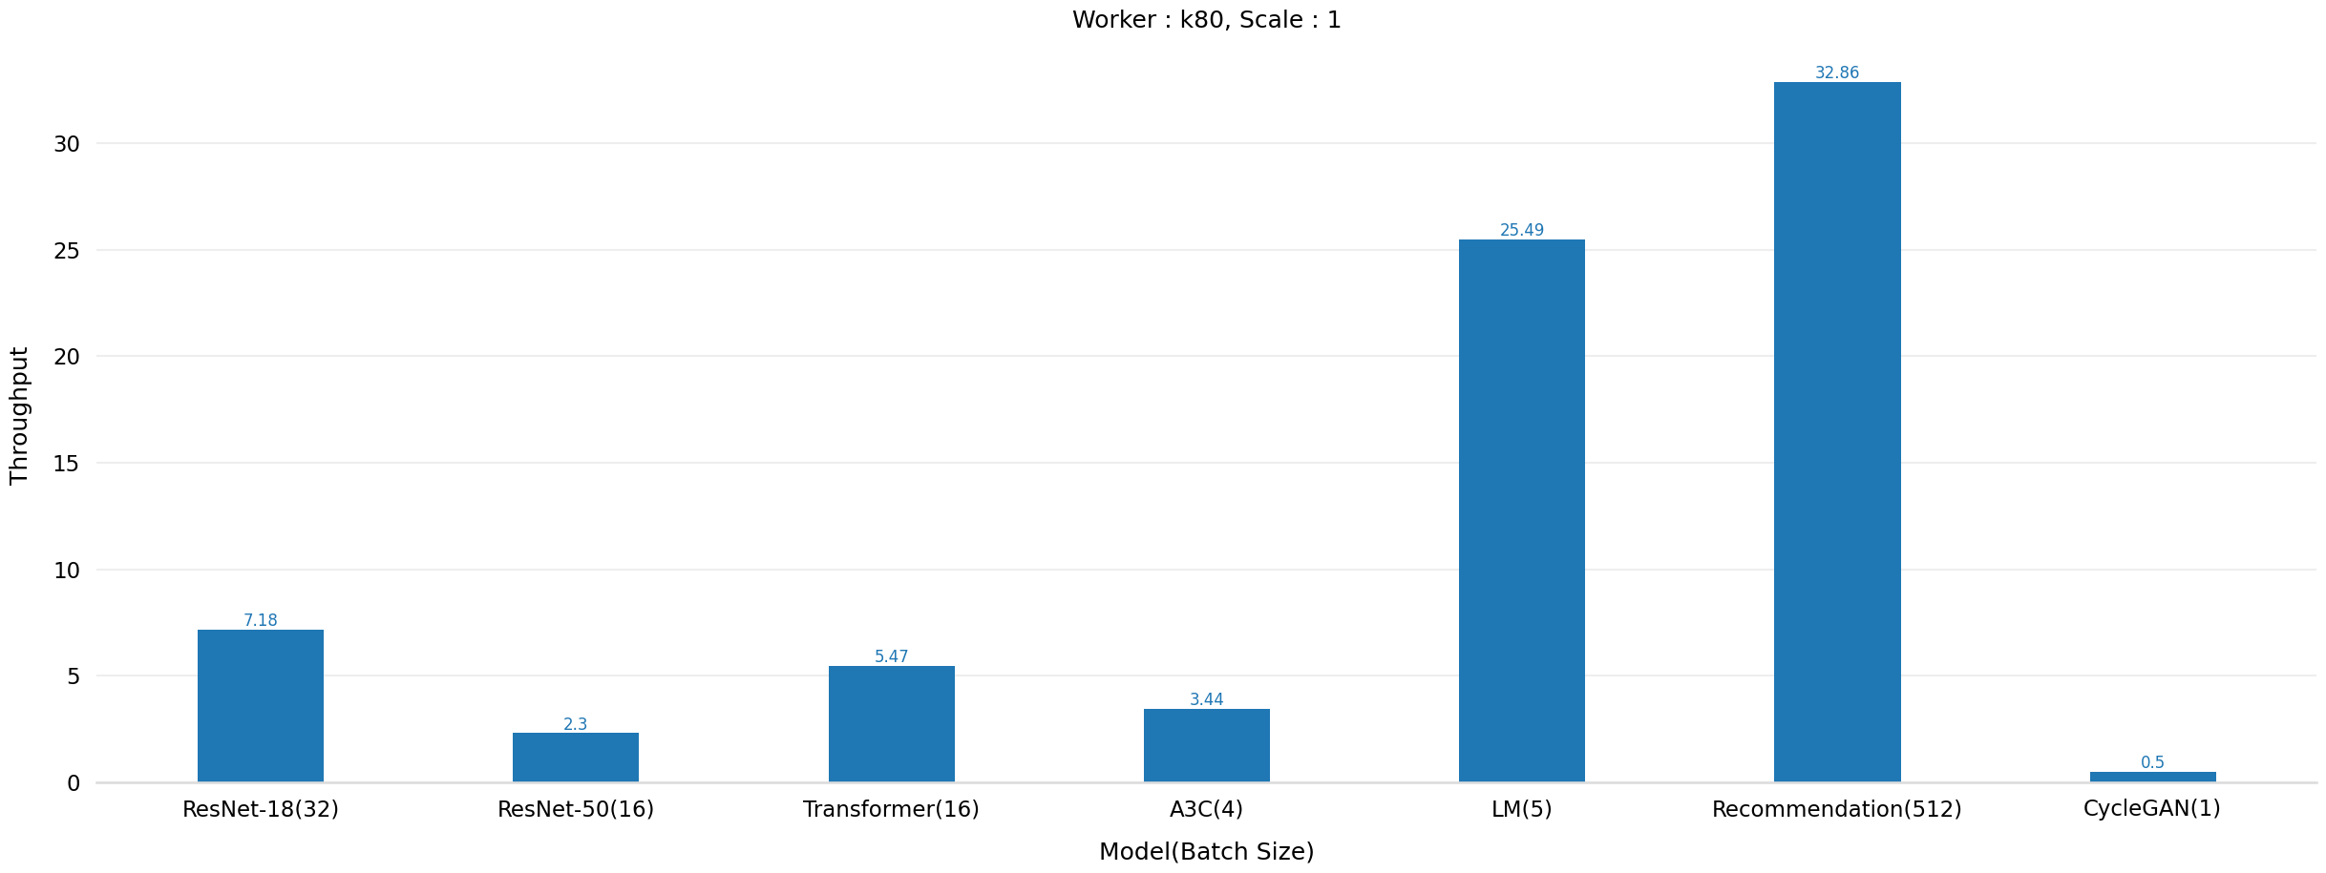
Throughput of different models on a k80 worker with scale=1.

Slide 12
Utilization analysis

Slide 13
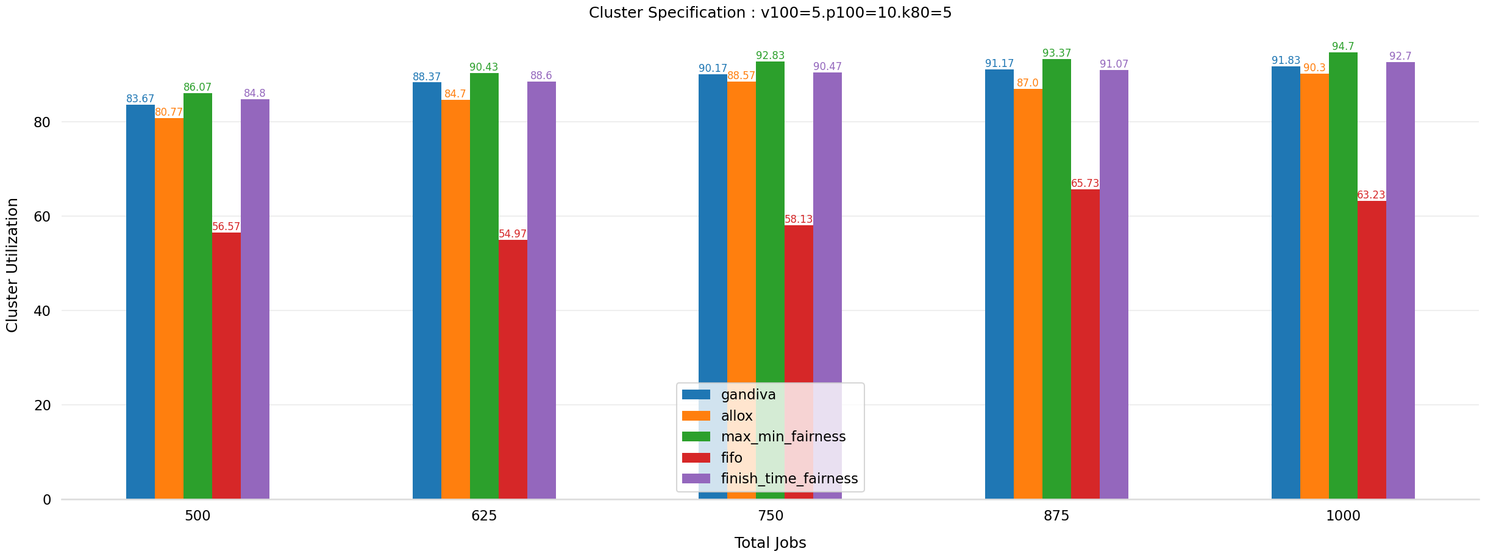
Cluster Utilization of different scheduling policies with the number of jobs.

Slide 14
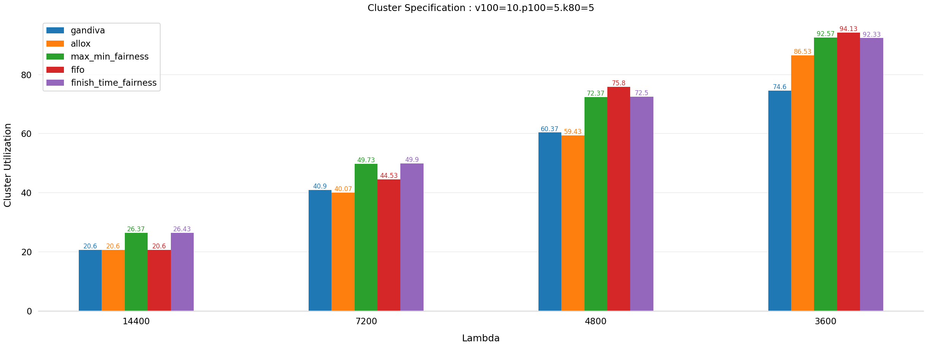
Increasing load
Cluster Utilization of different scheduling policies with lambda values.

Slide 15
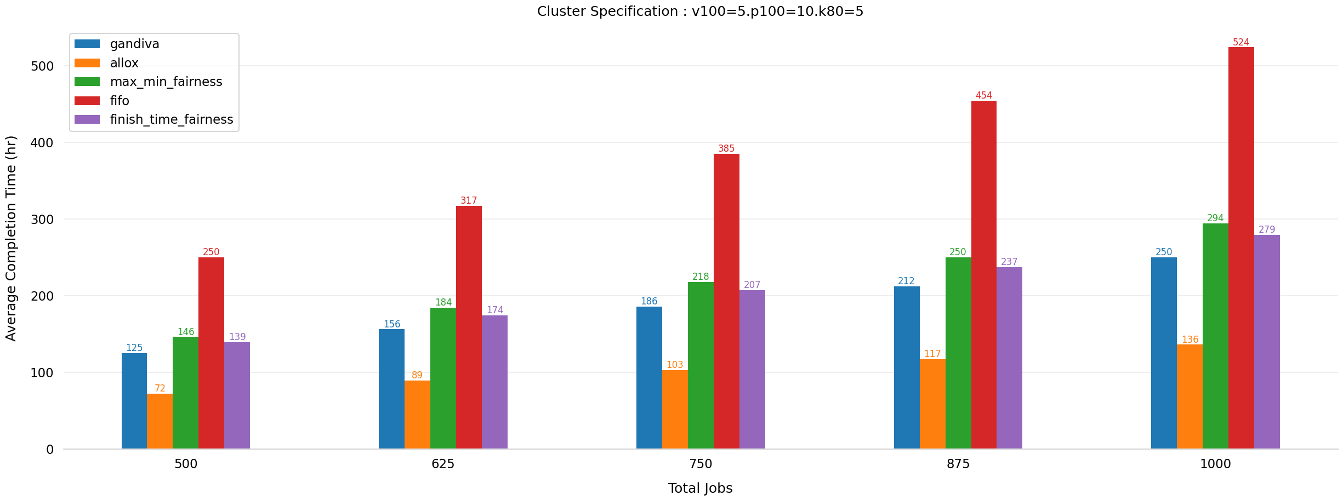
Average Job Completion Time of different scheduling policies with number of jobs.

Slide 16
Metric and Algorithm

Slide 17
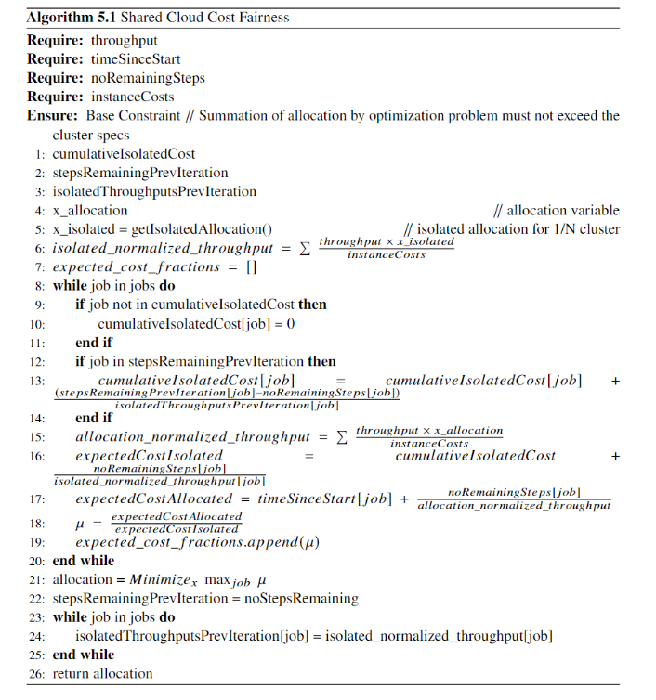

Shared Cloud Cost Fairness Metric

Slide 18
Evaluation

Slide 19
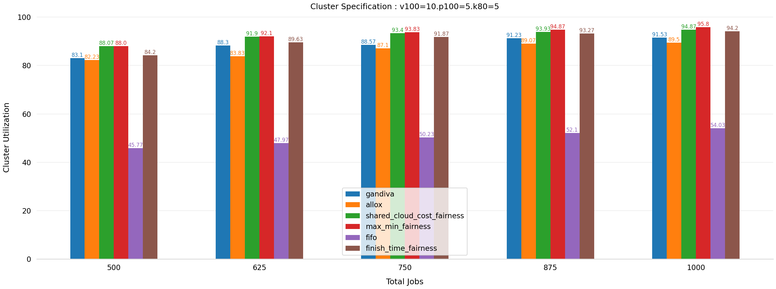
Comparison of Cluster Utilization of new policy with existing policies in static trace.

Slide 20
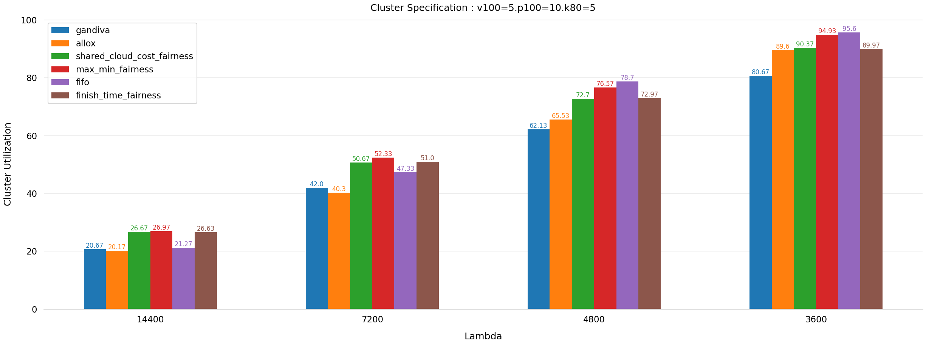
Increasing load
Comparison of Cluster Utilization of new policy with existing policies in continuous trace.

Slide 21
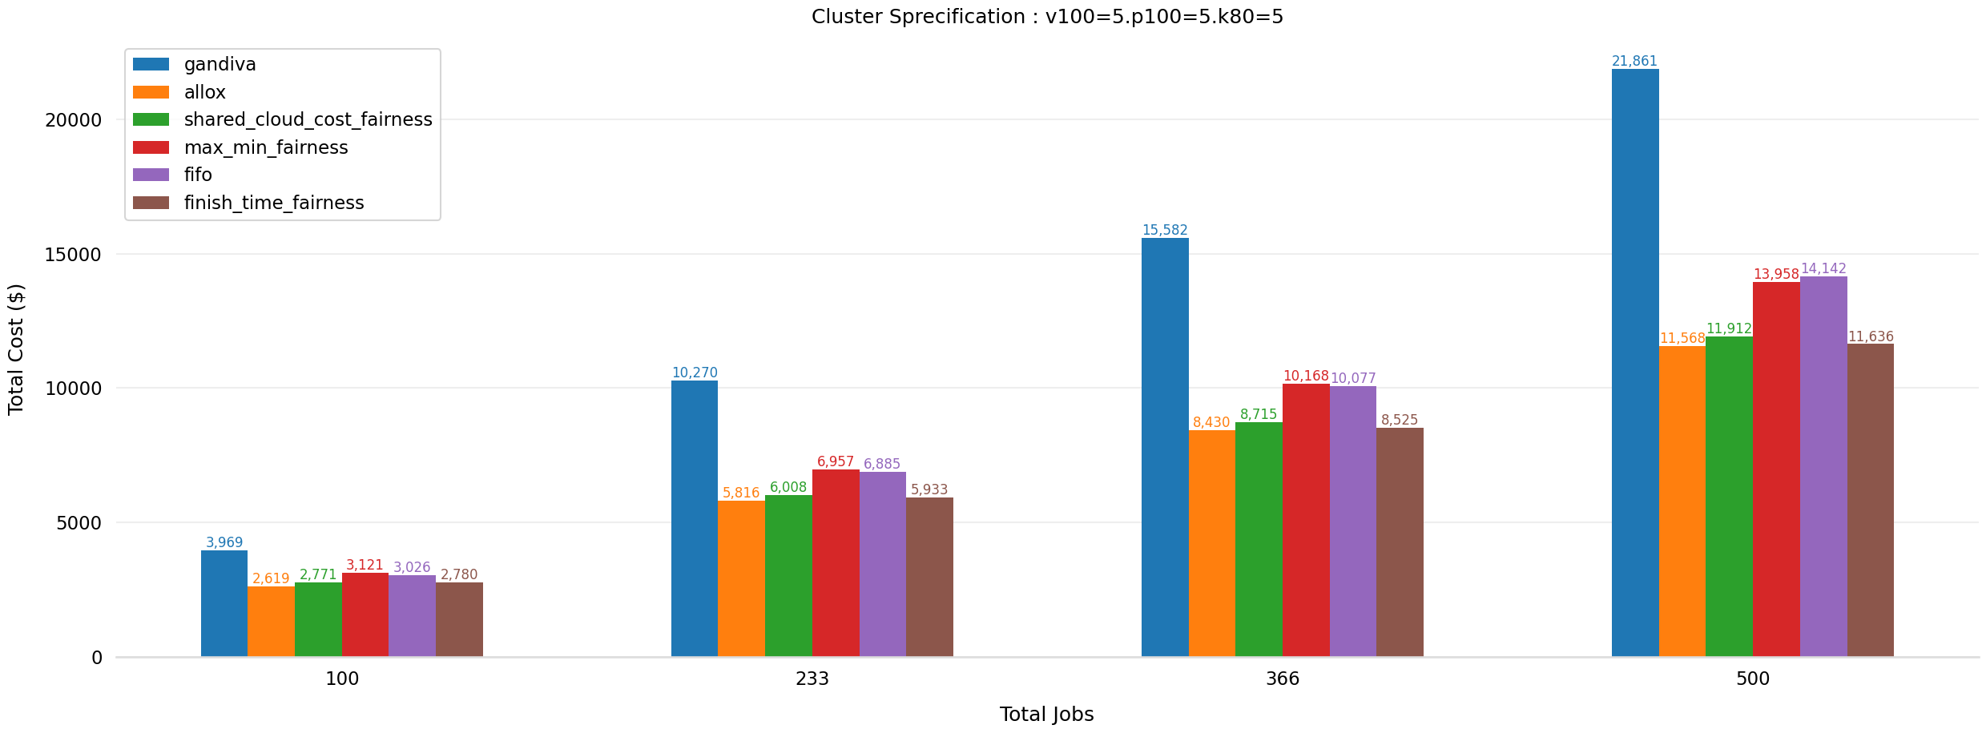
Cost Comparison of different scehduling policies with total number of jobs.

Slide 22
Conclusion

Slide 23
Conclusion
Factors impacting the throughput of Deep Learning Training jobs:
GPU Architecture
Model Architecture
Number of parameters
Location of GPU in the cluster
Utilization an important factor, but we also need to consider completion time.
Eg. FIFO.
Shared Cloud Cost Fairness policy provides good utilization along with cost savings.

Slide 24
Future Work

Slide 25
Future Work
Comparing simulated results with actual results on physical cluster.
Adding heuristics to include operational, maintenance and other costs.
Modification of metric to include power usage.
Changes in gavel to calulate cost for continuous trace.

Slide 26
Acknowledgements

Slide 27
Acknowledgements
Supervisor - Dr. Kawsar Haghshenas
IAAS department
University of Stuttgart

Slide 28
Questions?

Slide 29
Thank You

